Slide 1
Content Based Image Retrieval using Deep Learning

Slide 2
Agenda
Problem Definition.
Handcrafted based Features.
Deep Learning.
Convolutional Neural Network.
Network Designs.
Residual Neural Network(ResNet).
Results
End to End CBIR
Tools and Environments.
Future Work.

Slide 3
Problem Definition

Slide 4
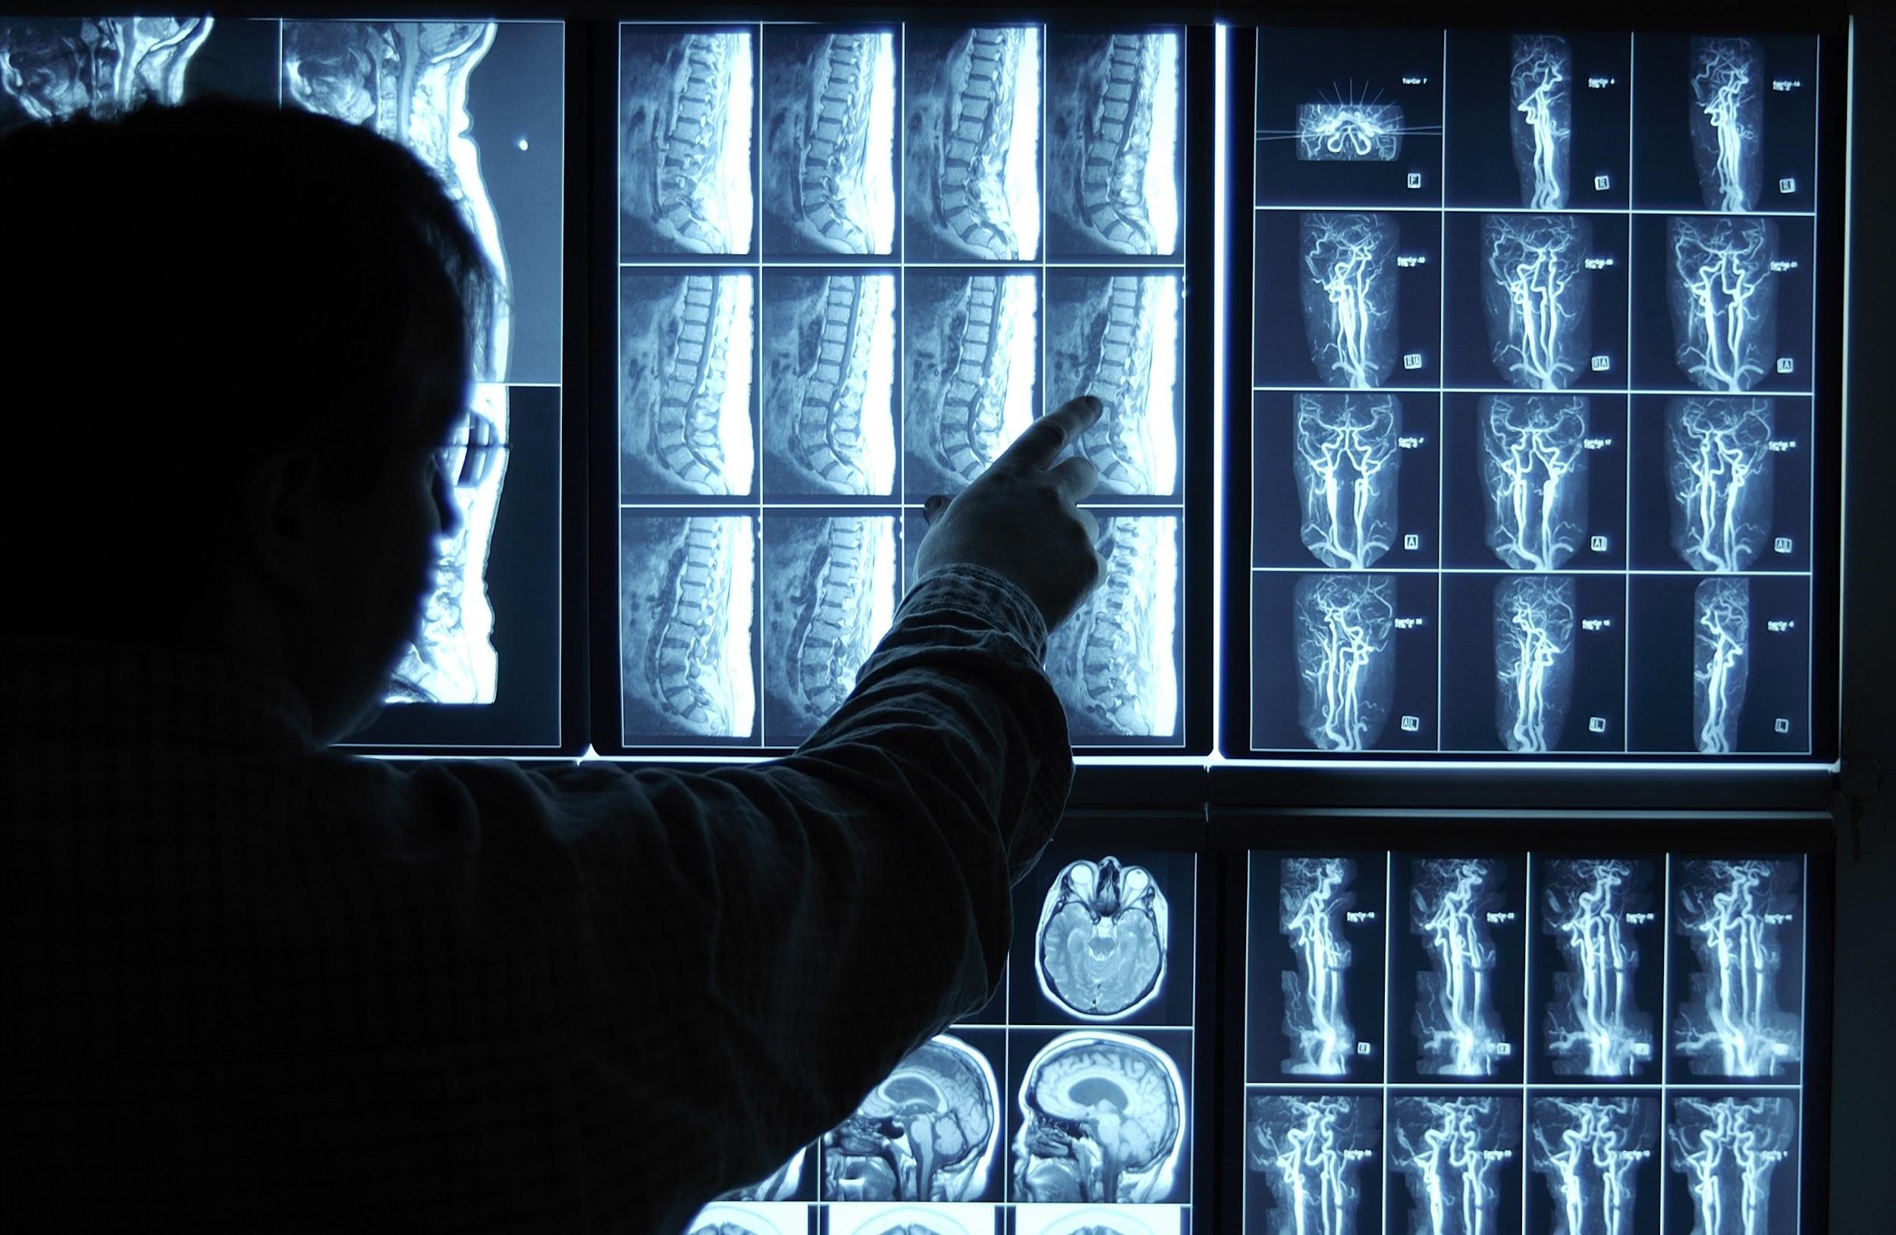
Problem Definition

Slide 5
Content Based Image Retrieval

Slide 6
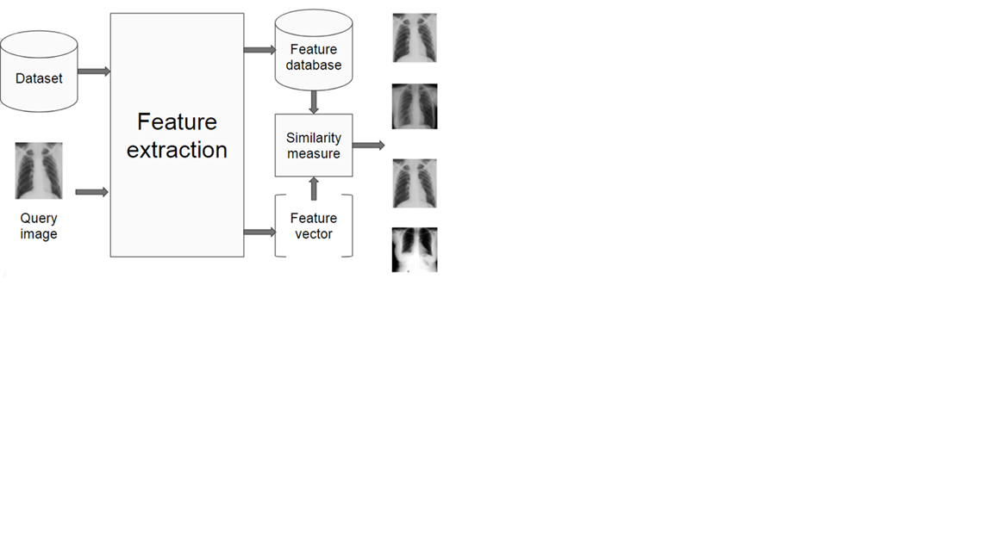
Content Based Image Retrieval

Slide 7
Phase I Handcrafted Features
Phase I fully reported in mid evaluation

Slide 8
Handcrafted Features
Color Features
Color Histogram
Texture Features
Gabor Filter
Tamura’s Features
Local Binary Pattern
Shape Features
SIFT
Histogram Oriented Gradients
Fourier Mellin

Slide 9
Handcrafted Features
Feature | Accuracy [%]
Fourier Mellin | 46.9
Gabor filter | 75.6
Tamura features | 80.7
Color histogram | 82.1
Local features | 87

Slide 10
Deep Learning

Slide 11
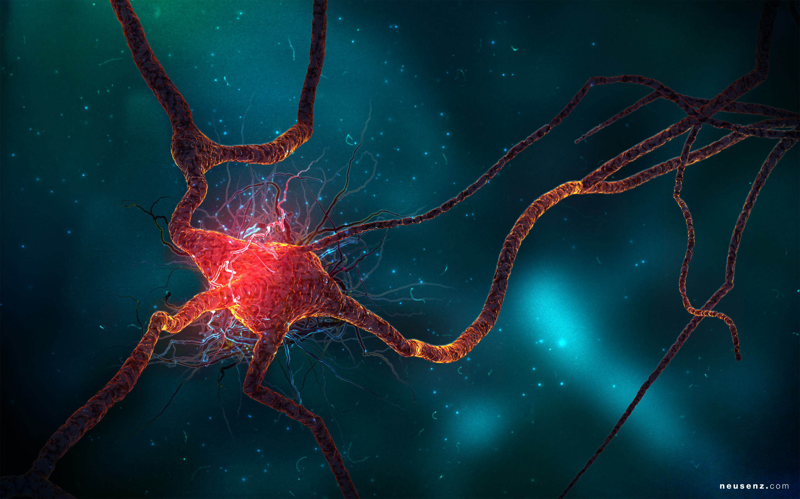

Slide 12
Convolutional Neural Network

Slide 13
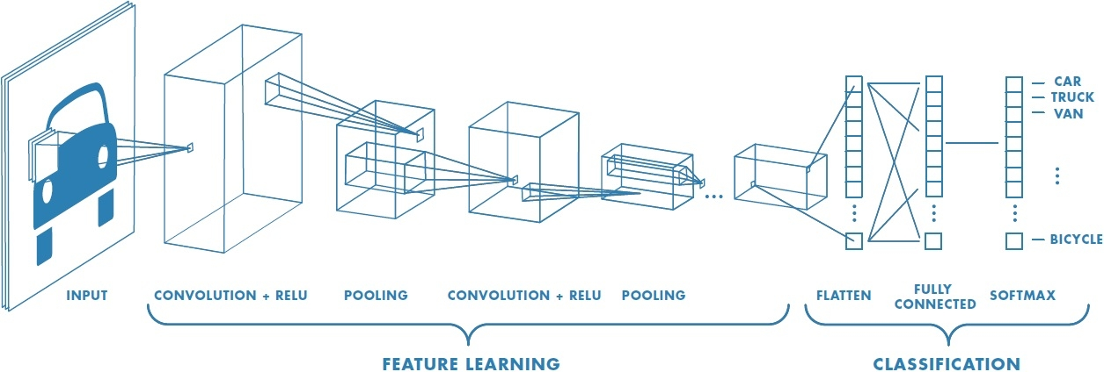
Architecture

Slide 14
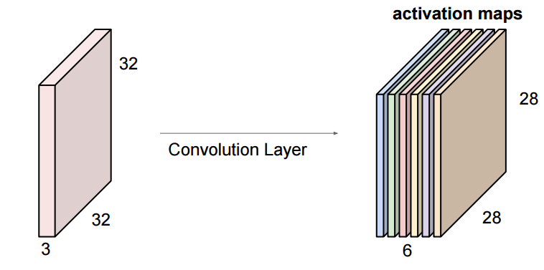
Convolutional Layer
+
ReLU Layer

Slide 15
Convolutional Layer
Filter:
Input image: 9x9
Output: 7x7

Slide 16
Convolutional Layer
One image becomes a stack of filtered images
=
=

Slide 17
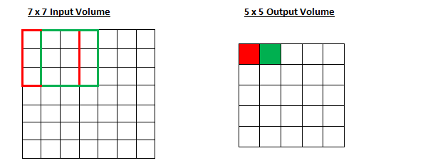
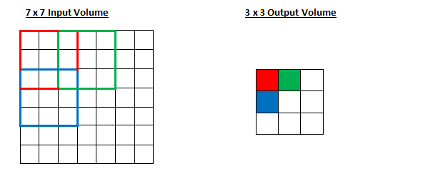
Stride
Stride = 1
Stride = 2

Slide 18
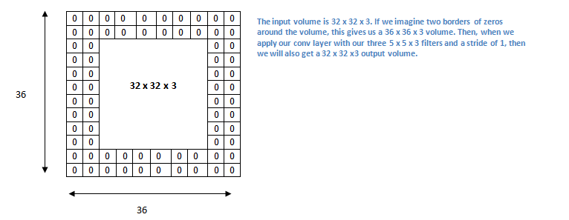
Padding

Slide 19
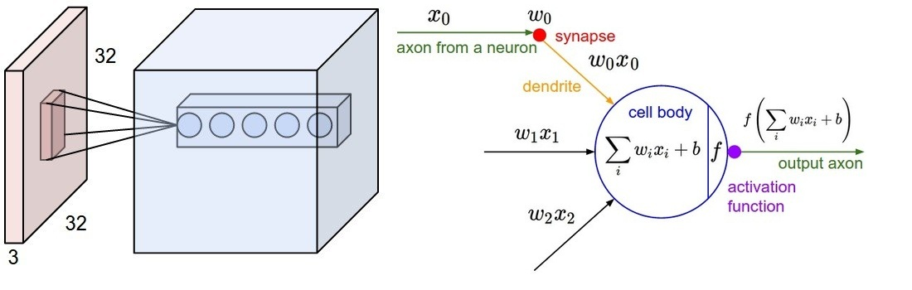
Sparse connectivity
Local region connection to full depth.

Slide 20
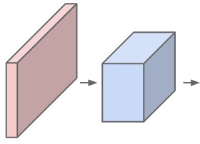
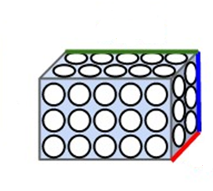
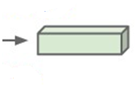
Example
depth
height
width
Input image
Convolution layer
Output

Slide 21
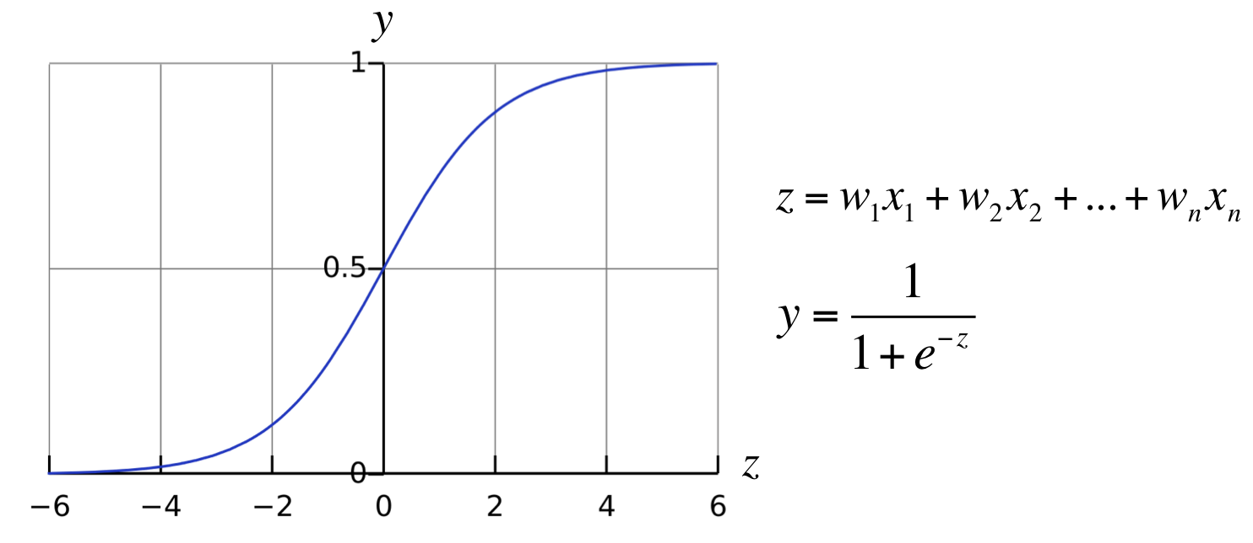
Activation Functions
Sigmoid function

Slide 22
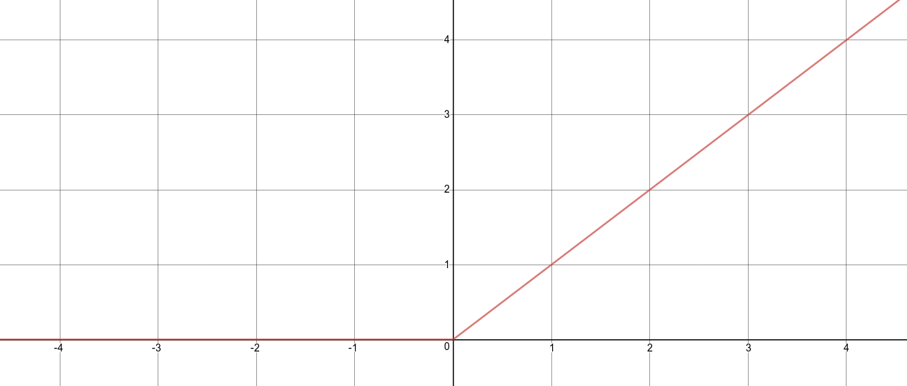

Activation Functions
Rectified Linear Unit (ReLU)
$$f\left(z\right)=max⁡(0,z)$$

Slide 23
ReLUs
23

Slide 24
ReLUs

Slide 25
ReLUs

Slide 26
ReLUs

Slide 27

Pooling layer
Single depth slice
1 | 1 | 3 | 4
5 | 6 | 7 | 8
3 | 2 | 1 | 0
1 | 2 | 3 | 4
Max pool with 2x2 filters and stride 2
6 | 8
3 | 4
x
y
21 | 8 | 8 | 12
12 | 19 | 9 | 7
8 | 10 | 4 | 3
18 | 12 | 9 | 10
Average pool with 2x2 filters and stride 2
15 | 9
12 | 7
x

Slide 28
Stacked layers
Convolution
ReLU
Pooling

Slide 29
Stacked layers
Convolution
ReLU
Convolution
ReLU
Pooling
Convolution
ReLU
Pooling

Slide 30
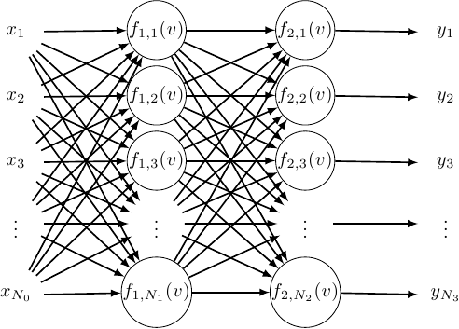
Fully connected layer

Slide 31
Fully connected layer
Convolution
ReLU
Fully
connected
Fully
connected
Convolution
ReLU
Convolution
ReLU
Pooling
Pooling
Class Scores

Slide 32
Hyper parameters

Slide 33
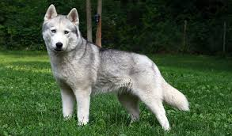
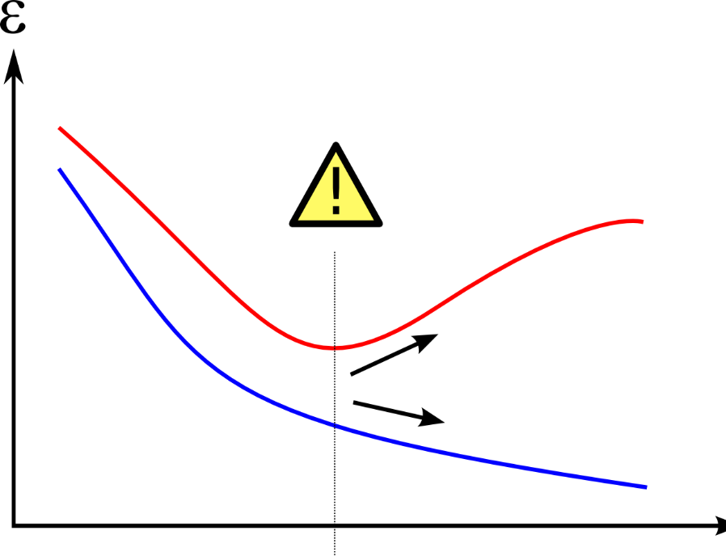
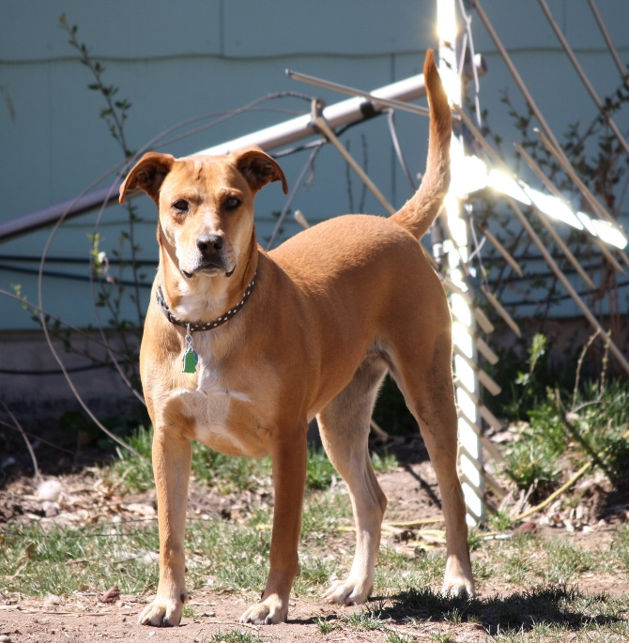
Overfitting
Testing data error rate
Training data error rate

Slide 34
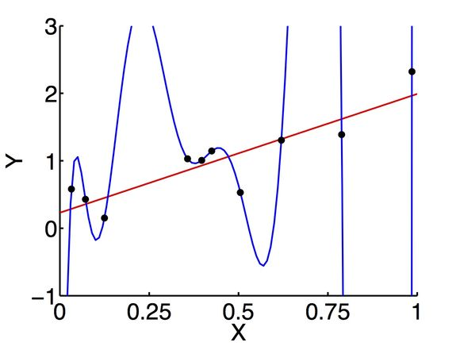
Overfitting

Slide 35
Regularization

Slide 36
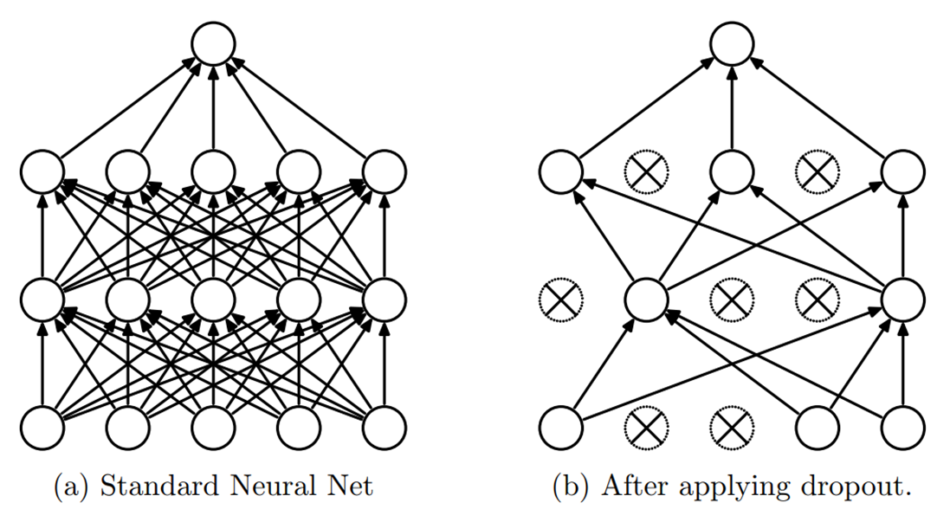

Dropout Layer

Slide 37
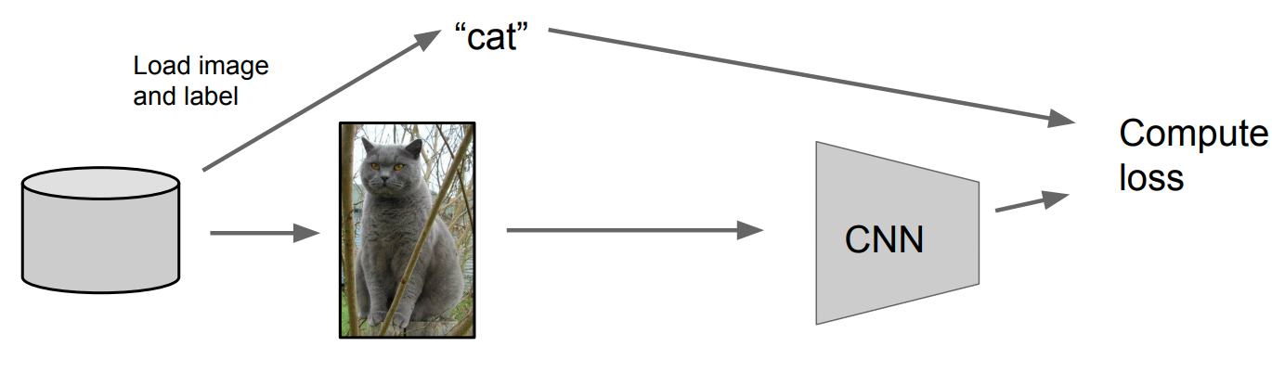
Data Augmentation

Slide 38
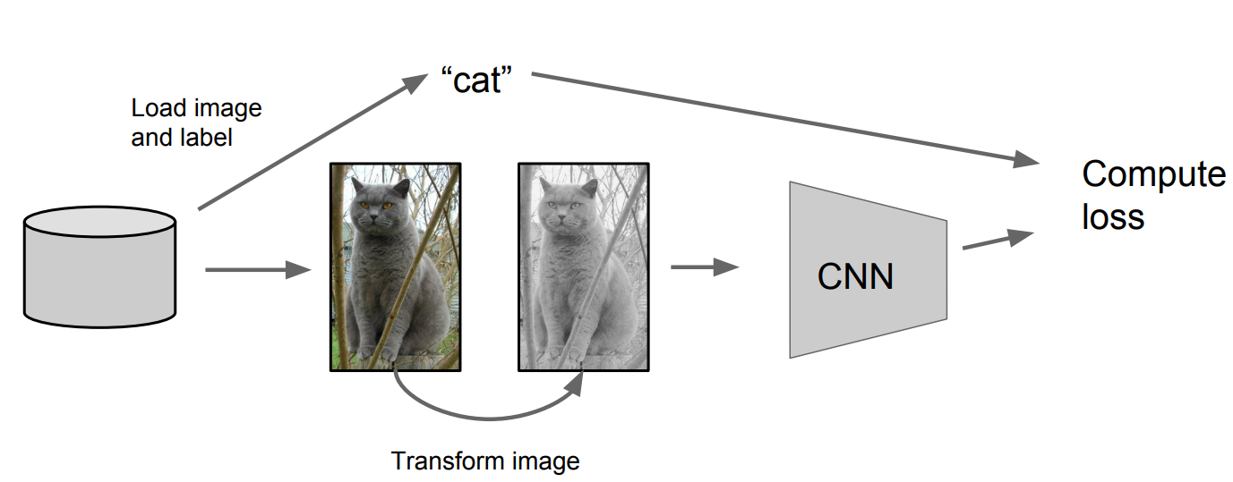
Data Augmentation

Slide 39
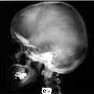
Data Augmentation
1. Horizontal and Vertical Flips

Slide 40
Data Augmentation
2. Rotations with 90, 180, 270
Original
90
180
270

Slide 41
Data Augmentation
3. Crops/Scales
Cropping
Scaling

Slide 42
Dataset

Slide 43
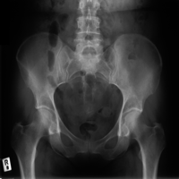
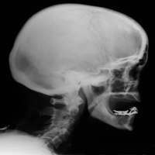
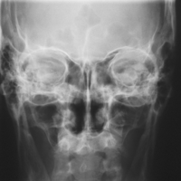
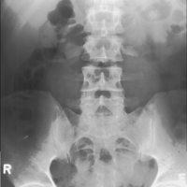
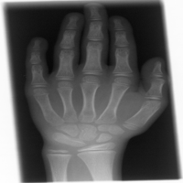
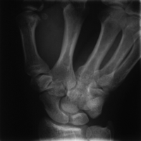
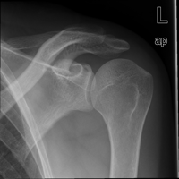
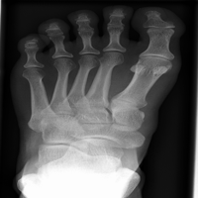
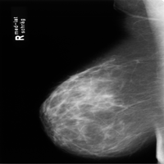
Dataset
IRMA DATASET IMAGE RETRIEVAL IN MEDICAL APPLICATIONS
14410 Anonymous radiographs
9 main categories,193 subcategories
Different ages, genders, view, positions & pathologies
Acquired by the Radiology Department Aachen university of technology, Germany

Slide 44
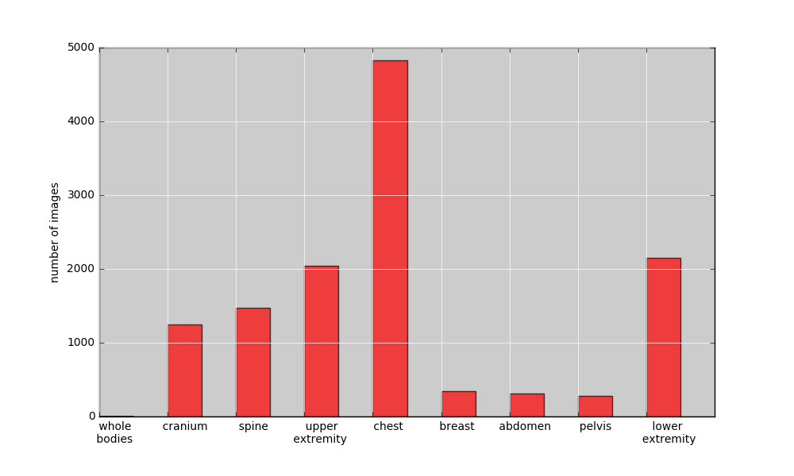
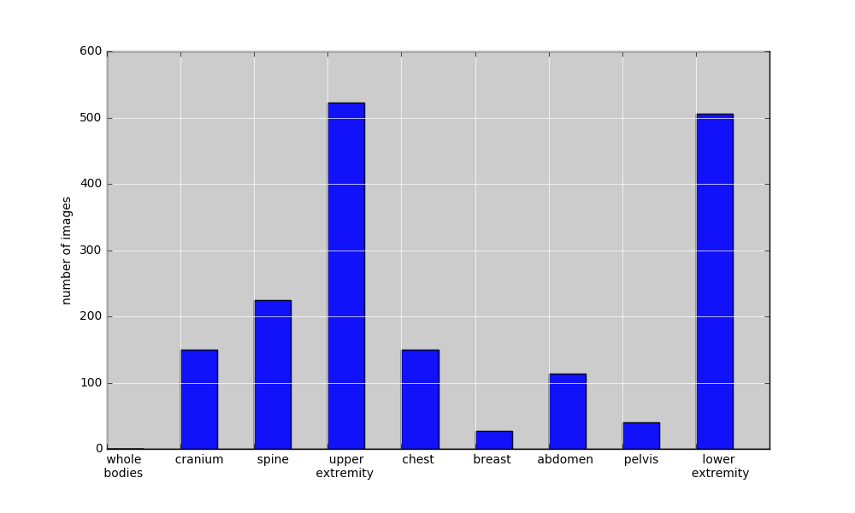
Dataset
Classes distribution:
Training dataset
Test dataset

Slide 45
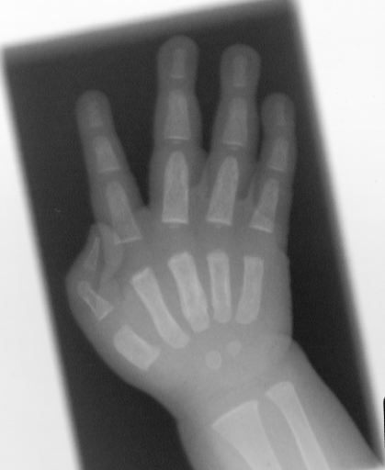
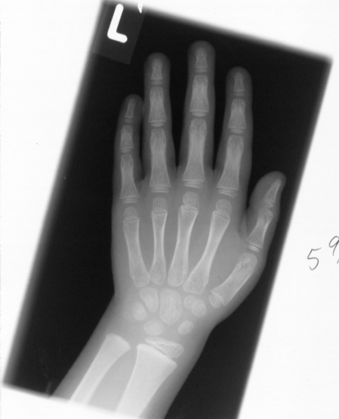
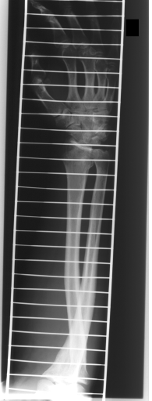
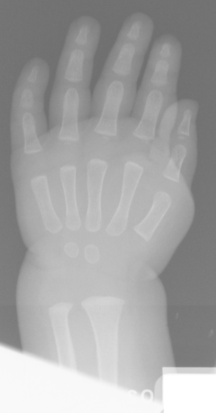
Dataset
Intra-class variation: same main class-subclass/anatomical part/direction

Slide 46
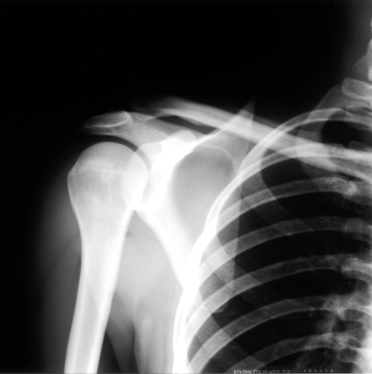
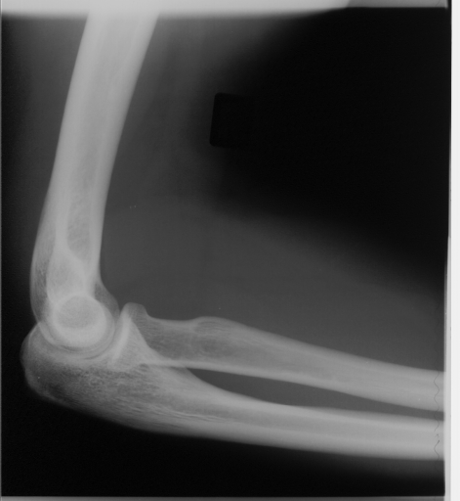
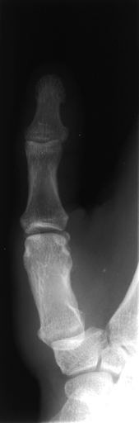
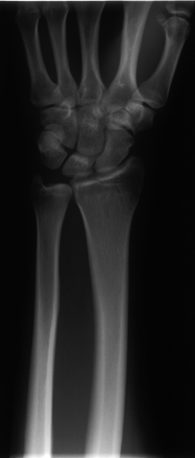
Dataset
Inter-subclass variation: same main class

Slide 47
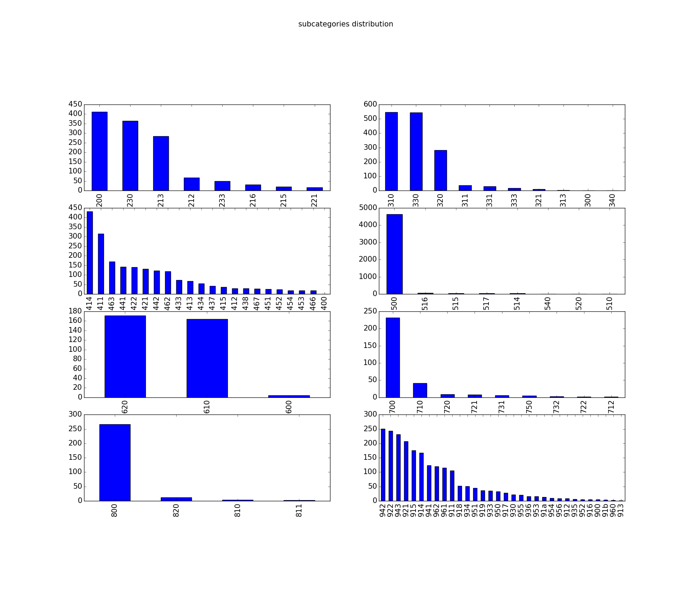
Dataset
Subclasses Distribution

Slide 48
Dataset
Classes chosen:
Discard some main classes with low sample distribution
work on a coarser to finer levels choice:
3 classes (spine, cranium, chest)
4 classes (spine, cranium, chest, limb “merge upper and lower extremity” )
5 classes (spine, cranium, chest, upper extremity, lower extremity)

Slide 49
Architecture design approaches
How many layers, Depth , Regularization.

Slide 50
Design approach
Fix hyper- parameters
Test different architecture
Analyze output

Slide 51
Choice of filter size

Slide 52
Choice of filter size
Design heuristics:
2012, 2013 used large filters sizes (11x11) (7x7) with large strides(2,3).
2014 used small filter sizes (5x5) (3x3) with small stride (1,2).
2015, 2016 networks depth (number of layer).

Slide 53
5x5 vs 3x3

Slide 54
5x5 vs 3x3
Input image
Image patch

Slide 55
5x5
First conv
Feature map
(5x5) image patch

Slide 56
3x3
Output of First 3x3 conv
(5x5) image patch

Slide 57
3x3
Output of First 3x3 conv
(5x5) image patch

Slide 58
3x3
Output of First 3x3 conv
(5x5) image patch

Slide 59
3x3
Output of First 3x3 conv
(5x5) image patch

Slide 60
3x3
Output of First 3x3 conv
(5x5) image patch

Slide 61
3x3
Output of First 3x3 conv
(5x5) image patch

Slide 62
3x3
Output of First 3x3 conv
(5x5) image patch

Slide 63
3x3
Output of First 3x3 conv
(5x5) image patch

Slide 64
3x3
Output of First 3x3 conv
(5x5) image patch

Slide 65
3x3
(5x5) image patch
Output of First
3x3 conv
Output of Second 3x3 conv

Slide 66
5x5 vs 3x3
So, what's the difference ?

Slide 67
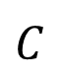
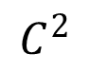
5x5 vs 3x3
W
W
Suppose input is H x W x C
convolutions with C filters
stride 1, Padding used
H , W x C are preserved
H
H
$$C^{}$$
$$C^{2}$$

Slide 68
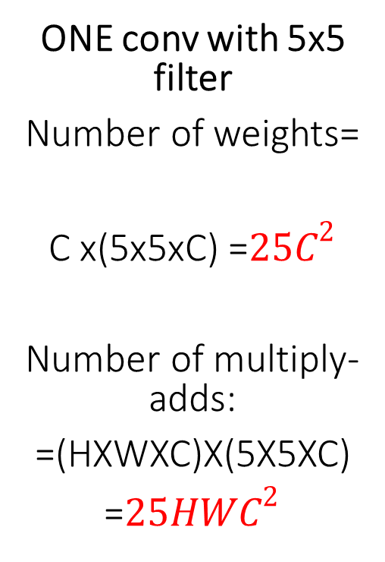
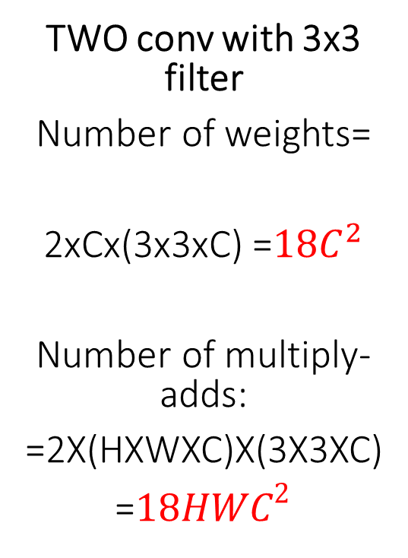
5x5 vs 3x3
W
ONE conv with 5x5 filter
Number of weights=
C x(5x5xC) =${25C}^{2}$
Number of multiply-adds:
=(HXWXC)X(5X5XC)
=${25HWC}^{2}$
TWO conv with 3x3 filter
Number of weights=
2xCx(3x3xC) =${18C}^{2}$
Number of multiply-adds:
=2X(HXWXC)X(3X3XC)
=${18HWC}^{2}$
W
H
H
More conv-ReLu layers:
More conv, more hierarchal feature construction.
More ReLu, more able to fit complex problems.
$$C^{}$$
$$C^{2}$$

Slide 69
5x5 vs 3x3
W
ONE conv with 5x5 filter
Number of weights=
C x(5x5xC) =${25C}^{2}$
Number of multiply-adds:
=(HXWXC)X(5X5XC)
=${25HWC}^{2}$
TWO conv with 3x3 filter
Number of weights=
2xCx(3x3xC) =${18C}^{2}$
Number of multiply-adds:
=2X(HXWXC)X(3X3XC)
=${18HWC}^{2}$
W
Less multiply-adds operations:
Faster training/inference
H
H
$$C^{}$$
$$C^{2}$$

Slide 70
Network design

Slide 71
Design I basic architecture / Effect of dropout tested
3 layers
1 conv filter per layer (3x3)/(5x5)
3x3 conv,20
2x2 pool
2x2 pool
3x3 conv,20
3x3 conv,20
2x2 pool
 | Accuracy [%]
Network | w/o dpout | w/ dpout
3x3 | 43.1 | -
5x5 | 85.73 | 87.93
5x5 conv,20
2x2 pool
2x2 pool
5x5 conv,20
5x5 conv,20
2x2 pool

Slide 72
Design II 3x3 vs 5x5 / Effect of dropout tested
3 layers
2 conv filter per layer (3x3),1 conv filter per layer (5x5)
3x3 conv,20
3x3 conv,20
2x2 pool
2x2 pool
3x3 conv,20
3x3 conv,20
3x3 conv,20
2x2 pool
3x3 conv,20
 | Accuracy [%]
Network | w/o dpout | w/ dpout
3x3 | 91.11 | 92.03
5x5 | 85.73 | 87.93
5x5 conv,20
2x2 pool
2x2 pool
5x5 conv,20
5x5 conv,20
2x2 pool

Slide 73
Design III more higher level features at last 3x3 layer
3 layers
2 conv filter per layer (3x3).1 conv filter per layer (5x5)
3x3 conv,20
3x3 conv,20
2x2 pool
2x2 pool
3x3 conv,20
3x3 conv,20
3x3 conv,20
3x3 conv,20
3x3 conv,20
2x2 pool
 | Accuracy
Network | w/ dpout
3x3 | 92.69
5x5 | 87.93
5x5 conv,20
2x2 pool
2x2 pool
5x5 conv,20
5x5 conv,20
2x2 pool

Slide 74
Design IV effect of increasing depth
4 layers
2 conv filter per layer (3x3).1 conv filter per layer (5x5)
5x5 conv,20
5x5 conv,20
2x2 pool
2x2 pool
2x2 pool
3x3 conv,20
5x5 conv,20
5x5 conv,20
3x3 conv,20
3x3 conv,20
3x3 conv,20
2x2 pool
 | Accuracy
Network | w/ dpout
3x3 | 89.28
5x5 | XX
5x5 conv,20
2x2 pool
2x2 pool
5x5 conv,20
5x5 conv,20
2x2 pool
2x2 pool
5x5 conv,20

Slide 75
Effect of Augmentation
3/4 layers
1 conv filter per layer (5x5)
5x5 conv,20
2x2 pool
2x2 pool
5x5 conv,20
5x5 conv,20
2x2 pool
 | Accuracy
Network | w/o AUG | w/ AUG
3 layers | 87.93 | 88.38
4 layers | XX | 90.38
2x2 pool
2x2 pool
5x5 conv,20
5x5 conv,20
5x5 conv,20
2x2 pool
2x2 pool
5x5 conv,20

Slide 76
Increasing Number Of Layers
Residual networks

Slide 77
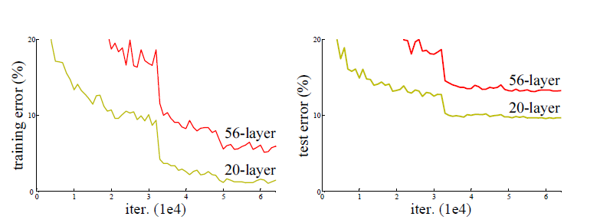
Increasing Number Of Layers
Experiments showed that the number of layers (depth) of a CNN is correlated to the performance in image classification tasks, on the contrary increasing the depth of the network shows an unexpected behavior

Slide 78
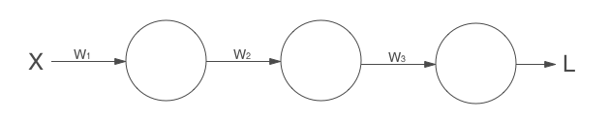
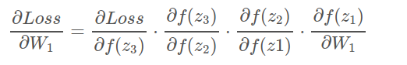
Increasing Number Of Layers
Vanishing Gradients:
Training the parameters of early Layers of the Network using Back-Propagation become difficult as convergence takes a Long time due to the very small changes in updating weights that called vanishing of Gradients.

Slide 79

Residual Neural Networks
Instead of hopping stacked layers directly, we explicitly let these layers fit a residual mapping which will act as skipping layers or “shortcuts”.

Slide 80


Residual Neural Networks
Plaint net
Residual net

Slide 81

Residual Neural Networks
Plaint net
Residual net

Slide 82

Residual Neural Networks
Plaint net
Residual net

Slide 83



Residual Neural Networks
Very smooth forward propagation
Any $x_{l}$ propagates forward directly to any $x_{L}$ Through residual units shortcuts.

Slide 84




Residual Neural Networks
To perform back-propagation using error function (E) to update the Lth layer ($x_{l}$) by calculating the derivative $\frac{dE}{dx(l)}$ :

Slide 85

Residual Neural Networks
Hence:
Any $\frac{dE}{dx(L)}$ is directly back-propagate to any $\frac{dE}{dx(l)}$

Slide 86
Network design

Slide 87
Design I Effect of resnet conception
3 layers
1 conv filter per layer (3x3)/(5x5)
3x3 conv,20
3x3 conv,20
2x2 pool
3x3 conv,20
3x3 conv,20
3x3 conv,20
2x2 pool
2x2 pool
Res Unit
Res Unit
Network | Accuracy [%]
w/ pool | 88.9
w/o pool | 91.1
3x3 conv,20
3x3 conv,20
3x3 conv,20
3x3 conv,20
2x2 pool
3x3 conv,20
2x2 pool
Res Unit
Res Unit

Slide 88
Classification Accuracy
Compared With Handcrafted Feature

Slide 89
Classification Accuracy
Feature | Accuracy [%]
Fourier Mellin | 46.9
Gabor histogram | 75.6
Tamura histogram | 80.7
Color histogram | 82.1
Local features | 87
3 layers,1 (3x3)filter, w/o dpout | 43.1
3 layers,2 (3x3)filter, w/dpout | 92.03
3 layers,2/3 (3x3)filter ,w/dpout | 92.69
4 layers,2 (3x3)filter, w/dpout | 89.28
3 layers,1 (5x5)filter, w/AUG | 88.38
4 layers,1 (5x5)filter, w/AUG | 89.15

Slide 90
End to End CBIR

Slide 91
End to End CBIR

Slide 92

Precision-Recall

Slide 93




Precision-Recall
Chest
cranium
Limb
Spine

Slide 94
Precision-Recall
Averaged P/R of 15 retrieved images.
Class | precision[%] | Recall[%]
Chest | 1 | 0.0030
Cranium | 1 | 0.0107
Upper/lower extremity | 0.97332 | 0.00282
Spine | 0.89332 | 0.00794

Slide 95
Tools & Environments

Slide 96






Tools & environments
NVIDIA GTX960m

Slide 97
Future Work

Slide 98
Future Work
Going more deeper in ResNet.
Preprocessing.
Augmentation.
Applying Batch Normalization layer.
Hyperparametrs.

Slide 99
Workload Distribution

Slide 100




Workload
Mohamed A.El-
Marakbey
Literature review
3x3 architerctures
Cloud platform
CBIR
Mazen Fouad Mahdi
Literature review
5x5 architectures
CBIR
Ahmed Gamal
Osman
Literature review
Resnet
CBIR
Eslam Gamal Thabet
Literature review
hyperparameters
Dropout
Regulariaztion
Cloud platform
CBIR

